Slide 1
Job-Alike Training Campus Student Information Representatives
Friday, August 28, 2020
Federal State and Compliance
Sr. Manager, Wanda Thomas

Slide 2
Norms
Please mute your microphone and camera during the presentation.
Place your questions in the chat.
Raise your hand and we will call you at the end of the presentation if we have not addressed your question in the chat.

Slide 3
Agenda:
Compliance Monitoring Team
Snapshot Data / Important Dates
Enrollment/Withdrawal Process
No-Show Date
Membership Count Process
Attendance Process
Membership Reconciliation
Six Week Verification of Data
Certify Score Cards

Slide 4
Compliance Monitoring Team
This team reviews manual / data for Discipline and PEIMS Leavers/Dropouts, collaborates with special populations departments to ensure data integrity, conducts training and assists the State Reporting Team by overseeing the campus data correction process. In addition, they manage four Sr. Student Information Representatives.
Email | Senior Compliance Analyst | Sr. Student Information Rep
Heidi.Cisneros@houstonisd.org | Heidi Cisneros | Elizabeth Salazar/Lisa Shannon/Patricia Marshall/Berta Garcia
lsmith3@houstonisd.org | Latonya Smith | Angela Tillmon/Tamika Whitmire/Mechelle Whiting/Vacancy
vwinfree@houstonisd.org | Veda Winfree | Mildred Evans/Felicia Freeman/Rose Fuentes/Vacancy

Slide 5
Senior Student Information Representatives
This team monitors official ADA attendance, reviews ADA and OFSDP attendance by 6-week period to ensure the data is accurate, maintains attendance accounting records, reconciles student membership and absences, reviews manual records/data for Discipline and Leavers/Dropouts, and monitors campus PEIMS data to ensure compliance with TEA requirements
Email | Sr. SIR |  | Email | Sr. SIR
mevans7@houstonisd.org | Mildred Evans |  | esalazar@houstonisd.org | Elizabeth Salazar
rfuentes@houstond.org | Rose Fuentes |  | lshanno1@houstonisd.org | Lisa Shannon
pmarshal@houstonisd.org | Patricia Marshall |  | atillmo1@houstonisd.org | Angela Tillmon
ffreeman@houstonisd.org | Felicia Freeman |  | twhitmir@houstonisd.org | Tamika Whitmire
mwhiting@houstonisd.org | Mechelle Whiting |  | TBD | Vacancy
bgarcia3@houstonisd.org | Berta Garcia |  | TBD | Vacancy

Slide 6
School Start Window
Important Fall Dates
- Close of school-start window – September 25, 2020
What is the "School Start Window"?
The "School Start Window" is from the first day of school through the last Friday of September. It has been designated by TEA as the timeframe we are allowed to account for all students in grades 7-12 who attended Houston ISD last school year and may or may not have returned this school year. Students who did not leave the Texas Education System and did not enroll in another Texas Public School District must be reported as dropouts if they are not located and enrolled before the last day of the "School Start Window.

Slide 7
Important Dates
September 25, 2020
October 30, 2020
The "School Start Window" is from the first day of school through the last Friday of September. It has been designated by TEA as the timeframe that districts can account for all students in grades 7-12 who attended a Houston ISD last school year and may or may not have returned this school year. Students who did not leave the Texas Education System and did not enroll in another Texas Public School District must be reported as dropouts if they are not located and enrolled before the last day of the "School Start Window".
PEIMS Snapshot (Always last Friday in October) Students must be identified of their special population's designation on or before this date.
Close of School Start Window (Always last Friday in September)

Slide 8
Important Dates

Slide 9
Report Card Dates

Slide 10
Membership Reporting
Membership figures should be shown by grade level (EE through 12). All students who are physically present in school on the first day are to be counted in their respective grade level, even though they may be in a self-contained special education class.
After the first day of school, membership includes all students who have enrolled and attended at least one day during the current school year and who have not withdrawn. Students who enrolled but have not attended at least one day should not be included in the membership count.

Slide 11
Membership Reporting
An application will be available for reporting membership figures in ALL schools by grade level beginning the week of 9/8/2020. Authorized staff will log in to the HISD Employee Portal by 10:00 am for elementary campuses and 11:00 am for secondary campuses
Beginning September 14, 2020, all schools will post membership by 10:30 am.
Click on Membership Reporting on the HISD Applications Links list to access the system.
Please refer to the Memo to Principals about Membership Figures for the School Year 2020-2021 for all dates on membership reporting.
A primary user and an alternate should be designated by the principal for inputting data.

Slide 12
Membership Count Process
Membership and attendance should be posted, verified and reconciled daily
Details of this process will be provided via TEAMS meeting with your SR. SIR

Slide 13
Teacher Roster Reconciliation
According to the SAAH the purpose of conducting this State Required Mandate is to ensure students who are no longer enrolled to be removed from our SIS and reporting to TEA via Submission 1 Core Collection and weekly Enrollment Tracking.
The Teacher Roster Reconciliation involves the following campus personnel
Teachers
Campus Administrators
Campus SIRS
Campus PEIMS Coordinators
Reconciliation Date and detailed instructions will be provided later

Slide 14
Online Enrollment
Link to Online Enrollment site: https://www.houstonisd.org/enroll
This site has enrollment information for parents and links to the online enrollment tool.

Slide 15
Enrollment
Verification of Address – use on-line School Zone Search Tool
Birth Certificate (preferred but not required) or proof of identity
statement of the child’s date of birth issued for school admission purposes by the division of the Texas Department of State Health Services responsible for vital statistics
driver’s license
passport
school ID card, records, or report card
military ID
hospital birth record
adoption records
church baptismal record
any other legal document that establishes identity
Immunizations
30-day provisional enrollment for student transferring from another district; or
Student with 1st series completing next required doses as rapidly as is medically feasible

Slide 16
Enrollment Verification Steps
Below you will find a listing of high-level summary verification steps that will be required in efforts to ensure we are delivering accurate student information.
There will be manual processes incorporated at each step of the online approval
Pending Approval
Approval
Pending Delivery
Polish
Delivery
Verification Reports (PowerSchool)

Slide 17
Pending Approval Verification Process
Address Verification for either Transfer and Magnet Approval
An added field will be included on the parent enrollment; if a magnet campus is selected there will be a field to state contact School Office.
Campus SIRS will check to ensure all required documentation has been uploaded
Campus SIRS will need to verify address against utility
Campus SIRS will verify and confirm the relationship of guardian and student – if determined students live with someone other than legal guardian will need to be tagged for administrative involvement “Determination Residence of a Minor” Office School Choice (this is not an online document and must be requested)
Supporting documentation must be returned to Office of School Choice for review
e. District Search to confirm the student is not currently enrolled or previously enrolled
f. TSDS Student Search
Notes:
Verify if student has local ID number in PowerSchool
Access TSDS Unique ID to check to see if the student is listed in the Unique ID Database and to make sure the correct Unique ID number is used.
Essential when enrolling student from out of district
Helps avoid TSDS Unique ID discrepancies

Slide 18
Approval Verification Process
Campus SIRs will review the residency document.
Confirm students name against students’ proof of identity.
Information above should be loaded in the attachment document field

Slide 19
Pending Delivery Verification
Campus SIRS will confirm all required documents have been submitted
Enrollment form
Birth documents
Attached documents, parent ID, court documents
School records if available, ex: report care
Make sure you are in the Pending Approval View.
Delivery Verification
Select Approve and Continue
Confirm the record you approved is not in the Pending Approval view
Students records will be assigned a snap code
Notify the parent of the records approved

Slide 20
Enrollment
A student who is homeless as defined by the McKinney-Vento Homeless Education Act shall be admitted into HISD
Student Residency & Assistance Questionnaire (homeless) Foster Care Required Info
Home Language Survey
Students Released by FSC through FSC@houstonisd.org from 8/17/2020 until 09/4/2020

Slide 21
Withdrawal Process
A student can be withdrawn from school by either biological parent if no court action is involved, regardless of who enrolled the student in school, or by the person who signed the enrollment card and/or has legal custody of the student.
The SIS Student Withdrawal Form must be completed with all information requested. After the first week of school, if the student has been in attendance in the school for five days or more, academic grades must be recorded on the check-out sheet. All absences (excused, unexcused, and extracurricular) should be transferred with the student, so they may be recorded at the new school. The student's PEIMS ID number should be double-checked by utilizing the Unique ID (UID) Search on TSDS for accuracy. One copy of the withdrawal form is given to the parent/guardian; one copy is retained by the school; and another copy is sent to the receiving school, if known, together with a copy of the report card. The parent/guardian/student should be given the original report card, and the school should retain a copy in the student's permanent folder.
If a student withdraws from school before ADA time the effective date of withdrawal is that same day. If a student withdraws after ADA time, the effective withdrawal date is the next school day. Parents and legal guardians should be encouraged to give the school a 24-hour notice of withdrawal to allow time for the school staff to process the withdrawal form without disrupting classes.
A student is not in membership on the withdrawal date.
Write the effective date of withdrawal and the withdrawal code on the student's color-coded card. The color-coded card should then be filed alphabetically by grade level.
Write the applicable information on the Membership/ Transaction Log using the effective date of withdrawal (JJAEP and Young Learners ONLY). It is critical that withdrawals be entered in PowerSchool daily to avoid conflicts with other schools or within the statewide UID file.

Slide 22
Withdrawal Procedures for Non-Attending Students
The principal may only withdraw students for non-attendance after specific actions are taken and documented. These actions must include attempting to contact the parent and/or student to suggest possible interventions or alternative placement to prevent the student from leaving school.
For general education students between six and nineteen years of age, compulsory attendance laws apply. A student should not be withdrawn for non-attendance unless school personnel can document that appropriate procedures have been followed. For students in violation of compulsory attendance, and the student should be withdrawn using Withdrawal Code L98 – Other/Unknown. The parent should be notified in writing of this action and informed to re-enroll the student once they regain control.
THE WITHDRAWAL CODE OF L83 – ADMINISTRATIVE WITHDRAWAL SHOULD NOT BE USED WHEN WITHDRAWING STUDENTS FOR NON-ATTENDANCE.
School personnel may withdraw a student who is at least 19 years old and is voluntarily enrolled in school when he or she accumulates more than five unexcused absences in a semester. Your district may revoke the enrollment of such a student for the remainder of the school year, except that a district may not revoke enrollment on a day on which the student is physically present at school. A student who is removed from school under this provision will be considered a dropout for accountability purposes unless the student returns to school during the school-start window the following fall. =
This authority to revoke enrollment does not override the district’s responsibility to provide a free appropriate public education to a student who is eligible for special education services.
School personnel must not withdraw a student who is temporarily absent (for example, as a result of illness or suspension) but still a member of your district.
School personnel should decide the withdrawal date for a student who never officially withdrew from school, but whose whereabouts can no longer be determined, according to applicable local policies. For example, local policy may state that a student is withdrawn 10 days after he or she last attended if his or her whereabouts are unknown. Once withdrawn, a student in grades 7 through 12 must be reported as a school leaver on a 40203 Record and will possibly be considered a dropout according to Section 2 of the TSDS PEIMS Data Standards TEC, §25.085(e)

Slide 23
Attendance Updates
Asynchronous Attendance - The required amount of instructional time is scheduled each day, and funding is generated when attendance is recorded daily at a locally selected snapshot time.
Remote Asynchronous Instruction – Instruction that does not require having the instructor and student engaged at the same time.
No Optional Flexible School Day Attendance will be taken during Asynchronous Attendance
All campuses will follow the same guidelines during Asynchronous Attendance (i.e. – On-Time Grad Academy)
Campus Attendance Ambassador Team
State Reporting and Attendance Procedures Manual

Slide 24
Attendance Process – Elementary Campuses
By 10:00 a.m.
- Teachers will take attendance on the first day of school in PowerSchool Teacher
Students will be marked either
RA (Remote Asynchronous Present) or Absent
Students are present “RA” when…
1. Teams: A student attends asynchronous Teams lesson or,
2. HUB (LMS): A student engages on the HUB by…
a. Completing an activity/ assignment in HUB or
b. This criterion is only used when updating the previous days absences: Viewing content in the HUB (logging in for X minutes but does not complete the assignment) or,
3. Two-Way Communication: A student engages in a conversation with a teacher of record or SPED resource/co-teacher (cannot be a TA).
Between 10:01 a.m. – 2:29 p.m.
School Staff will call students marked absent for the current day
By 2:30 p.m.
Update ADA attendance for Students who engaged following Morning Attendance Deadline
Update ADA attendance for Students who engaged following previous Afternoon Attendance Deadline
6:00 p.m.
Automated call out reminder for all students who were marked absent in their homeroom period at Afternoon Attendance Deadline to complete assignments for attendance purposes.
No Shows will not be posted until Friday, September 11, 2020

Slide 25
Six Weeks Verification of Data
Campuses will be required to generate the Student Detail Report and Special Populations Detail Report for that cycle, each special populations coordinator will be responsible for their program verification by ensure all students are coded appropriately for that cycle.
Campuses will be responsible for ensuring Certica Data Errors are resolved during the reconciliation period for that cycle, once errors are corrected campuses will run the Campus Summary Report based on the date above.

Slide 26
Timelines
FSC Department has established timelines for all data related to student information and will disseminate these timelines to the schools at the beginning of the school year.
The department has developed a system to verify (see-data verification process) the completed tasks.
Timelines reflect dates and deadlines for each step of the data management process. Ultimately, schools are responsible for the delivery of student data on the specified due dates.

Slide 27
TSDS Collection Due Dates
Class Roster Fall submission 10/15/2020
Charter School Waitlist submission 10/30/2020
PEIMS Fall 1st submission 12/03/2020
PEIMS Fall resubmission 01/14/2021
PEIMS Midyear 1st submission 01/28/2021
ECDS Kindergarten submission 01/28/2021
PEIMS Midyear resubmission 02/11/2021
SPPI-14 submission 02/18/2021
Class Roster Winter submission 03/18/2021

Slide 28
TSDS Collection Due Dates (Continued)
PEIMS Summer 1st submission 06/17/2021
ECDS Prekindergarten submission 06/17/2021
ECDS Private Prekindergarten submission 06/17/2021
Special Education Language Acquisition 06/24/2021
PEIMS Summer resubmission 07/15/2021
RF Tracker submission 07/29/2021
PEIMS Summer year-round LEAs 08/12/2021
PEIMS Extended Year 1st submission 08/26/2021
PEIMS Extended Year resubmission 09/16/2021

Slide 29
Certify Scorecards
Certify allows for a flexible and varied collection of data validations, called “rules.” The rules can include business rule validations, checks for data consistency and accuracy, and alerts to ensure compliance with state or district policies.
Training available at: https://certicasolutions.com/certify-training.html.
Available Scorecards:
FHSP Scorecard (high schools only),
LEP Scorecard,
Student Behavior/Discipline Scorecard,
Student Information Scorecard, and
TSDS PEIMS Scorecards.

Slide 30
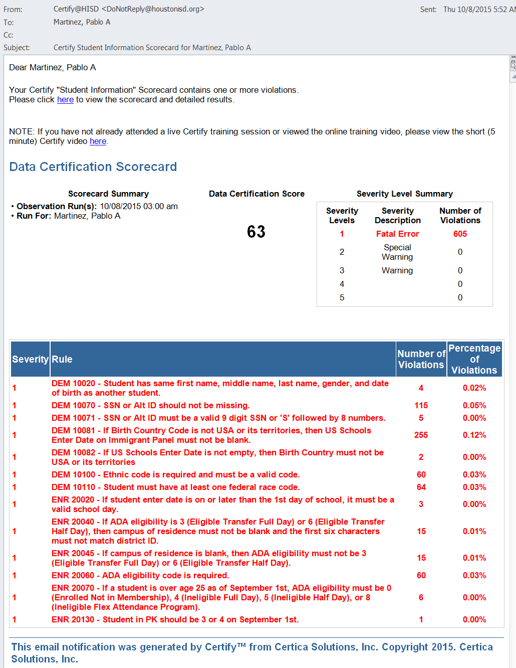
Certify Student Information Scorecard
Click “here” to
get to the log on
page.

Slide 31
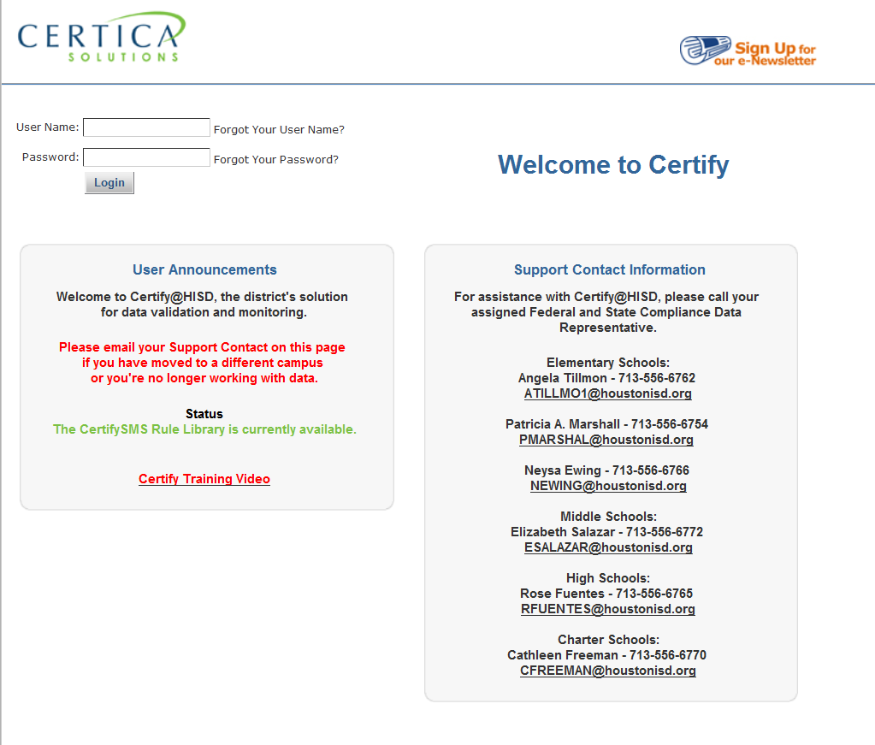
Certify Student Information Scorecard
Use the same user-ID
and password as you do
for PowerSchool.

Slide 32
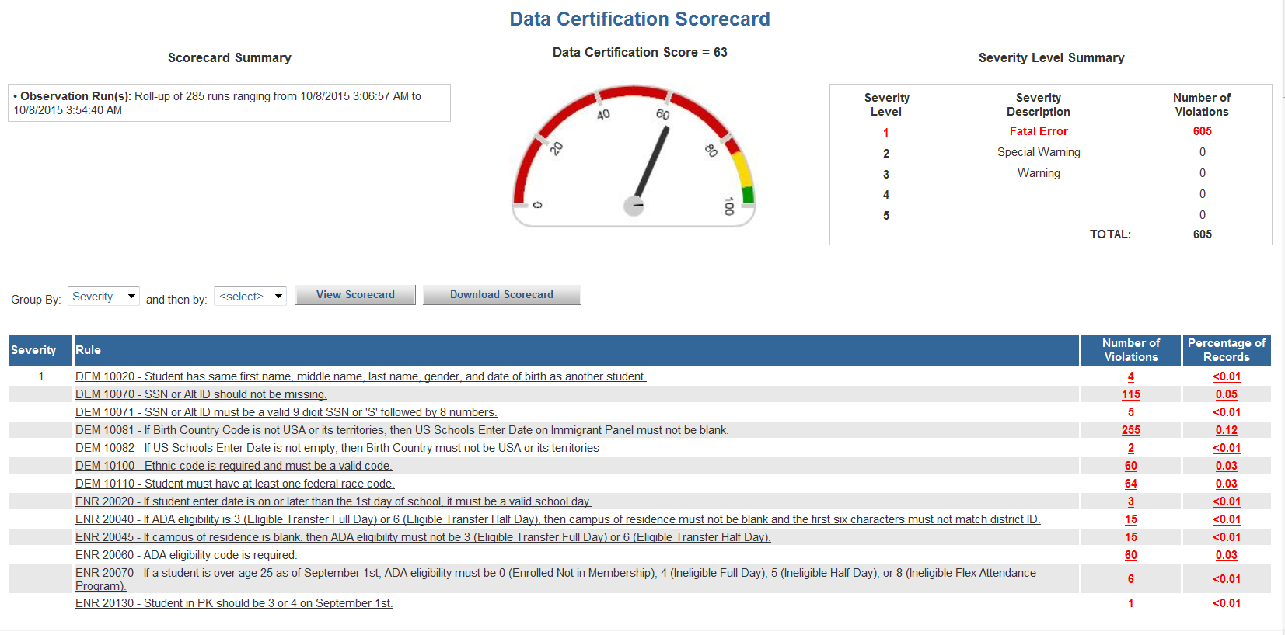
Certify Student Information Scorecard
Click on the individual number or any specific rule to see the error report.

Slide 33
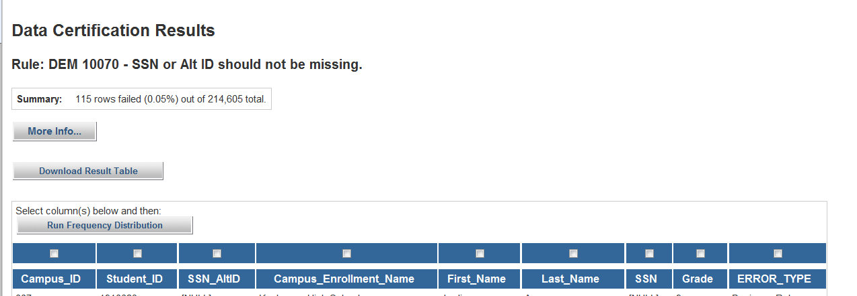
Certify Student Information Scorecard
NOTE: You can only open one rule report at a time.

Slide 34
Certify Scorecards
Campus PEIMS Coordinator or Principal designee must:
Ensure that the appropriate staff completes Certify training,
Determine which staff will have access to scorecards (Principal or designee)
Send access requests or changes to Pablo Martinez, pmartine@houstonisd.org.
Monitor scorecards daily and oversee correction of errors.
Contact your Federal and State Compliance Sr. Analyst with questions. DO NOT CONTACT CERTICA SOLUTIONS.

Slide 35
Upcoming Trainings
Department | Description | Webinar or Face to Face | Date | Start Time | End Time
FSC | FC_Enrollment Training (SIRS - Elementary) | Virtual | 10/15/2020 | 8:30 AM | 11:30 AM
FSC | FC_Enrollment Training (SIRS - Secondary) | Virtual | 10/15/2020 | 1:30 PM | 4:30 PM
FSC | FC_Enrollment Training (SIRS - Elementary) | Virtual | 10/15/2020 | 8:30 AM | 11:30 AM
FSC | FC_Enrollment Training (SIRS - Secondary) | Virtual | 10/15/2020 | 1:30 PM | 4:30 PM
FSC | FC_Enrollment Training (SIRS - Elementary) | Virtual | 1/4/2021 | 8:30 AM | 11:30 AM
FSC | FC_Enrollment Training (SIRS - Secondary) | Virtual | 1/4/2021 | 1:30 PM | 4:30 PM
FSC | FC_Enrollment Training (SIRS - Elementary) | Virtual | 1/4/2021 | 8:30 AM | 11:30 AM
FSC | FC_Enrollment Training (SIRS - Secondary) | Virtual | 1/4/2021 | 1:30 PM | 4:30 PM
FSC | FC_Enrollment Training (SIRS - Elementary) | Virtual | 3/3/2021 | 8:30 AM | 11:30 AM
FSC | FC_Enrollment Training (SIRS - Secondary) | Virtual | 3/3/2021 | 1:30 PM | 4:30 PM
FSC | FC_Enrollment Training (SIRS - Elementary) | Virtual | 3/3/2021 | 8:30 AM | 11:30 AM
FSC | FC_Enrollment Training (SIRS - Secondary) | Virtual | 3/3/2021 | 1:30 PM | 4:30 PM

Slide 36
Thank you

